Slide 1
P4 Programmable Data-Plane Switches
Joseph Telaak
Jorge Crichigno, PhD.
University of South Carolina - Columbia

Slide 2
Introduction/Background
Vendors like Cisco or Juniper control new feature rollout
Switches configurable not programmable
New protocol development expensive and time-consuming

Slide 3
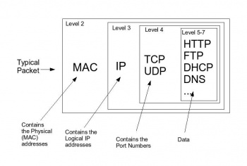
Packet
Essentially a letter
Message
Info about message
Mail
Mailboxes
Mail trucks
Post offices
Formatted unit
Control Info in header and footer
Data can be split between multiple packets
https://computersciencewiki.org/images/thumb/e/ec/Networkpacket.jpg/350px-Networkpacket.jpg

Slide 4
Packet Switches
Hubs
Switches
Physical Layer
Same as cabling
Send all packets out all ports
Insecure
Promiscuous hosts
Inefficient
No simultaneous streams
Getting unwanted packets
Other hosts cannot transmit
Use hardware addresses to send to the right port
Plug ‘n Play
Configurable Switches
Some have advanced features
Inter-VLAN Routing
Multiple logical networks on same hardware

Slide 5
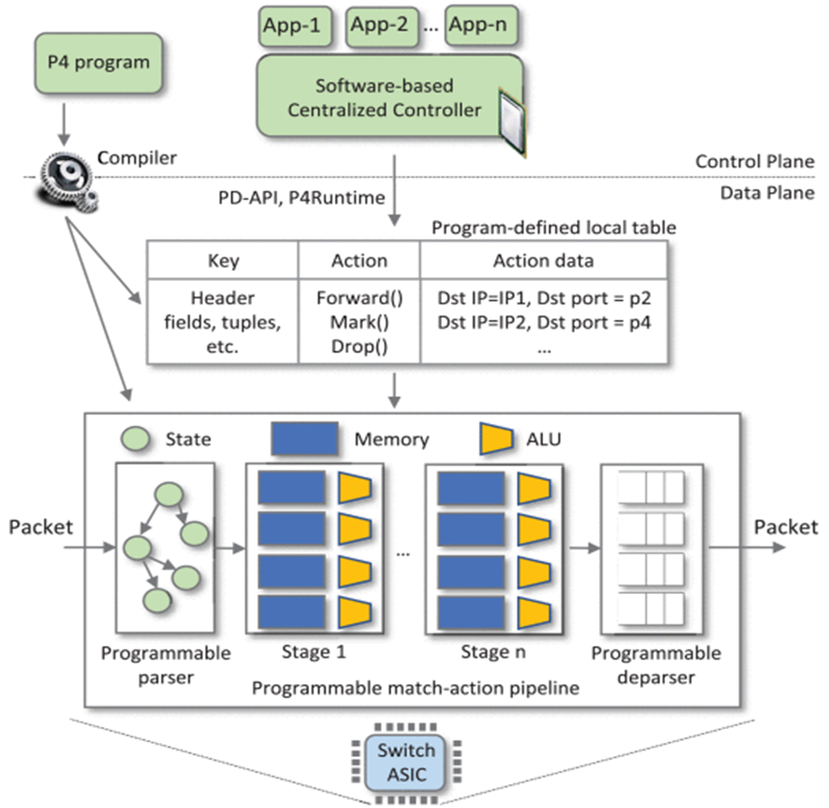
Control and Data Planes
Control Plane
Defines data-plane logic
Contains routing table
QoS
Somewhat configurable
Data Plane
Functions & Processes for packet switching
Parser & De-parser
Controlled by vendors
E. F. Kfoury, J. Crichigno and E. Bou-Harb, "An Exhaustive Survey on P4 Programmable Data Plane Switches: Taxonomy, Applications, Challenges, and Future Trends," in IEEE Access, vol. 9, pp. 87094-87155, 2021, doi: 10.1109/ACCESS.2021.3086704.

Slide 6

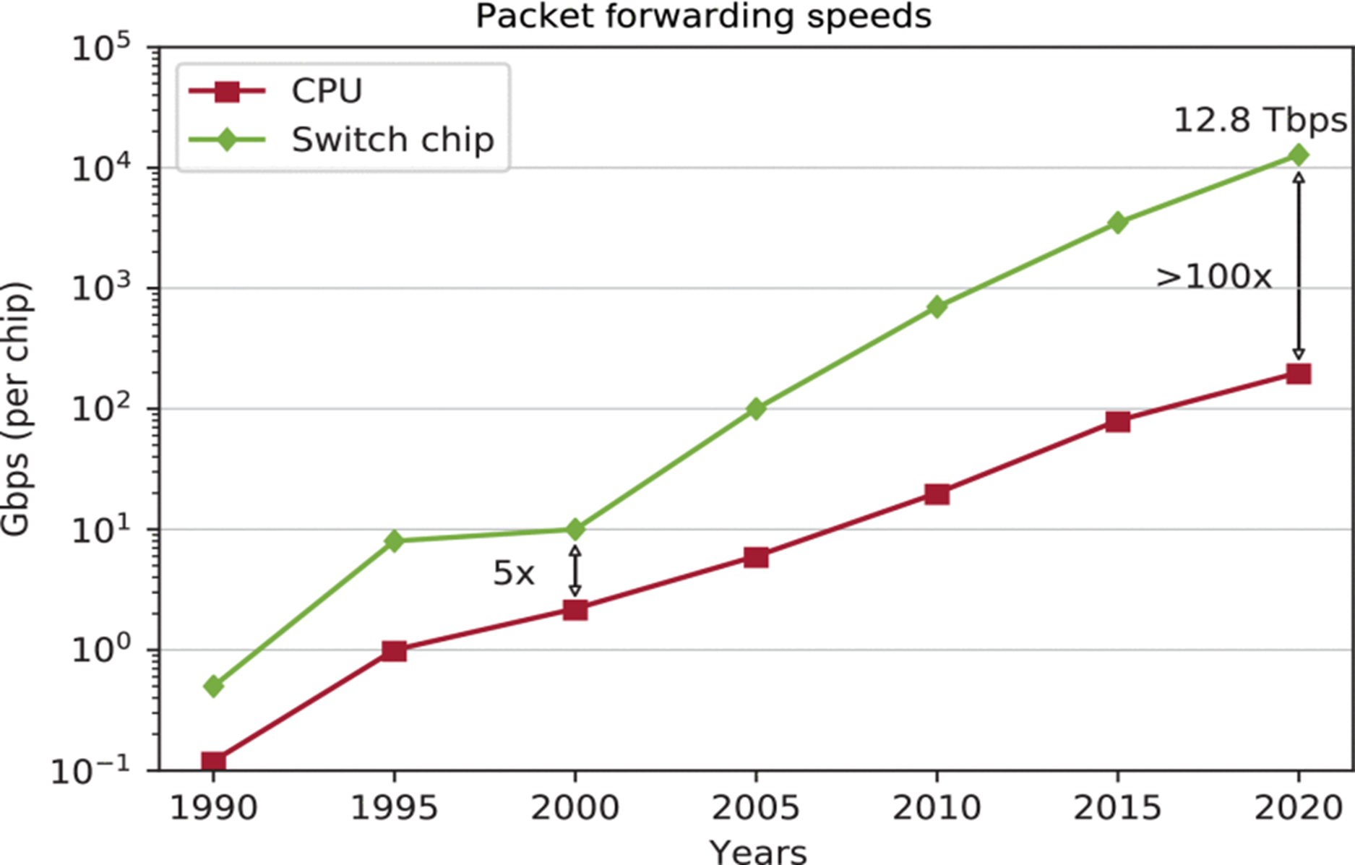
P4 (Programmable Protocol-Independent Packet-Processors)
Domain-Specific Programming language developed in 2014
Target-Independent (CPU & ASICs)
ASICs are significantly faster
No native protocol support
Everything defined by programmer
Increase efficiency by offloading processes onto the switch
E. F. Kfoury, J. Crichigno and E. Bou-Harb, "An Exhaustive Survey on P4 Programmable Data Plane Switches: Taxonomy, Applications, Challenges, and Future Trends," in IEEE Access, vol. 9, pp. 87094-87155, 2021, doi: 10.1109/ACCESS.2021.3086704.

Slide 7
Goal of Research
Specific Aims
Explore potential applications
Develop example applications
Deploy in test networks
Use the programmability of this hardware to develop real-world applications.

Slide 8
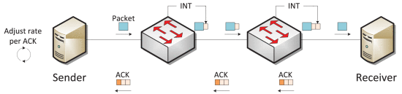
In-Band Network Telemetry (INT)
Add metadata in transit
Real-time telemetry
Adjust sending rates to reduce congestion
Congestion greatly reduced speed
Imagine video buffering or quality dip
E. F. Kfoury, J. Crichigno and E. Bou-Harb, "An Exhaustive Survey on P4 Programmable Data Plane Switches: Taxonomy, Applications, Challenges, and Future Trends," in IEEE Access, vol. 9, pp. 87094-87155, 2021, doi: 10.1109/ACCESS.2021.3086704.

Slide 9
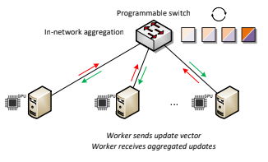
Machine Learning Aggregation
Aggregate calculations on switch instead of on workers
Aggregation requires little computing effort
Workers or dedicated machines aggregate updates
Switch processes this in-transit and increases efficiency
E. F. Kfoury, J. Crichigno and E. Bou-Harb, "An Exhaustive Survey on P4 Programmable Data Plane Switches: Taxonomy, Applications, Challenges, and Future Trends," in IEEE Access, vol. 9, pp. 87094-87155, 2021, doi: 10.1109/ACCESS.2021.3086704.

Slide 10
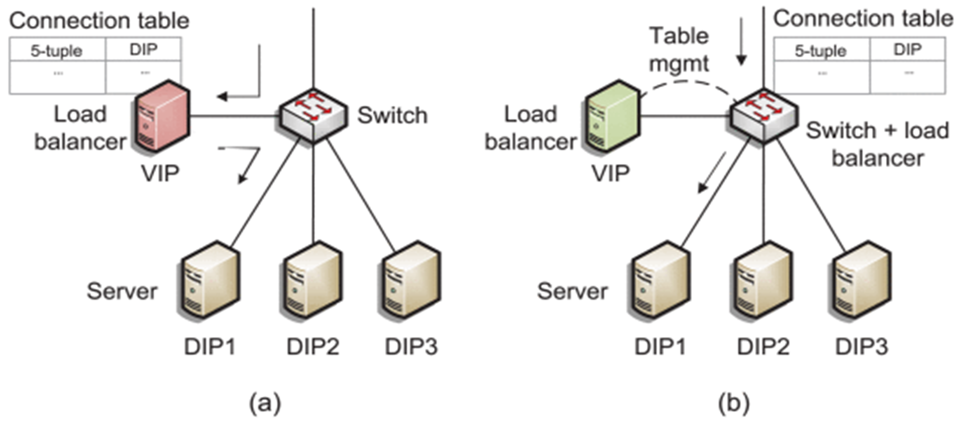
Load Balancer
Do forwarding on the switch
Manage table on a server
Decreases latency
Load balancer normally routes the packets
E. F. Kfoury, J. Crichigno and E. Bou-Harb, "An Exhaustive Survey on P4 Programmable Data Plane Switches: Taxonomy, Applications, Challenges, and Future Trends," in IEEE Access, vol. 9, pp. 87094-87155, 2021, doi: 10.1109/ACCESS.2021.3086704.

Slide 11
Conclusions & Future Directions
Conclusions:
Research was primarily exploratory
Future Directions:
Applications of P4 are limited by what is necessary in a specific installation

Slide 12
Acknowledgments
Dr. Jorge Crichigno, PhD.
Dr. Alfred DeGennaro
Elie Kfoury, Jose Gomez, Ali AlSabeh, Shahrin Sharif
NSF
GSSM
USC - Columbia

Slide 13
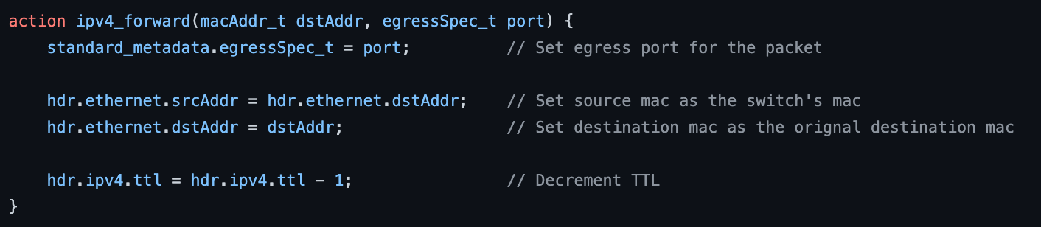
Basic Layer 2 Switch
Forwards packets based on their header (hdr)
Decrements TTL
Below images packet processing
Other parts of code
Computing checksum
Defining packet formats

